Slide 1
RNA-seq Introduction
Promises and pitfalls

Slide 2
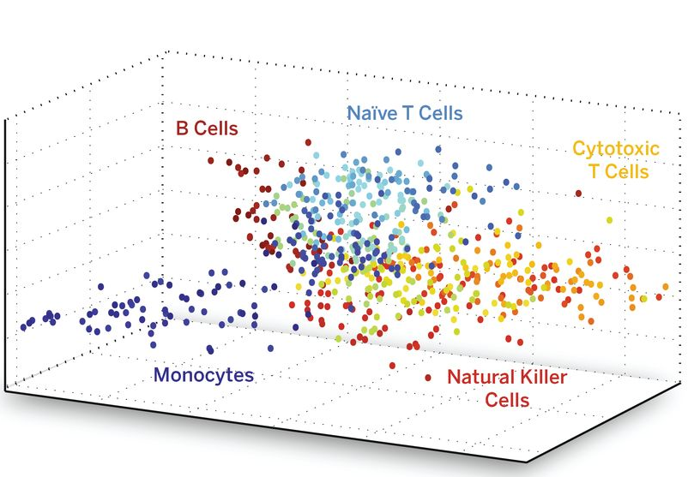
DNA is the same in all cells but which RNAs that is present is different in all cells

Slide 3
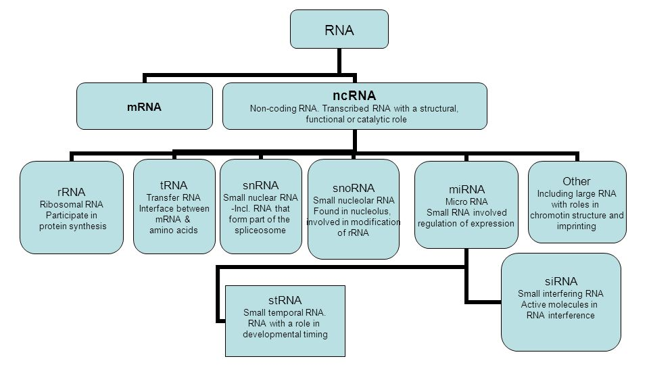
There is a wide variety of different functional RNAs

Slide 4
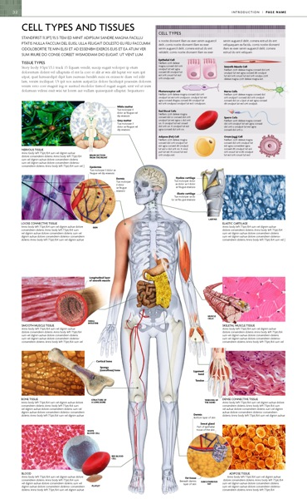
Which RNAs (and sometimes then translated to proteins) varies between samples
-Tissues
Cell types
Cell states
-Individuals
-Cells

Slide 5
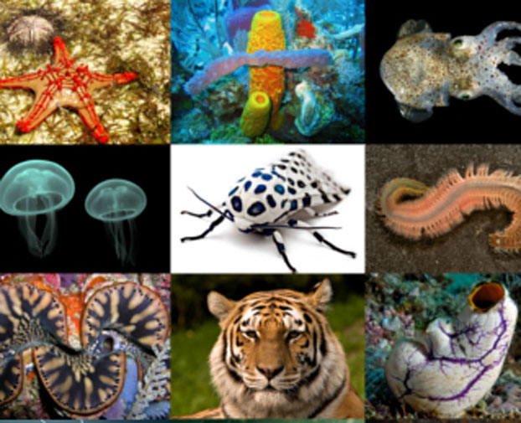
RNA gives information on which genes that are expressed
How DNA get transcribed to RNA (and sometimes then translated to proteins) varies between e. g.
-Tissues
Cell types
Cell states
-Individuals

Slide 6
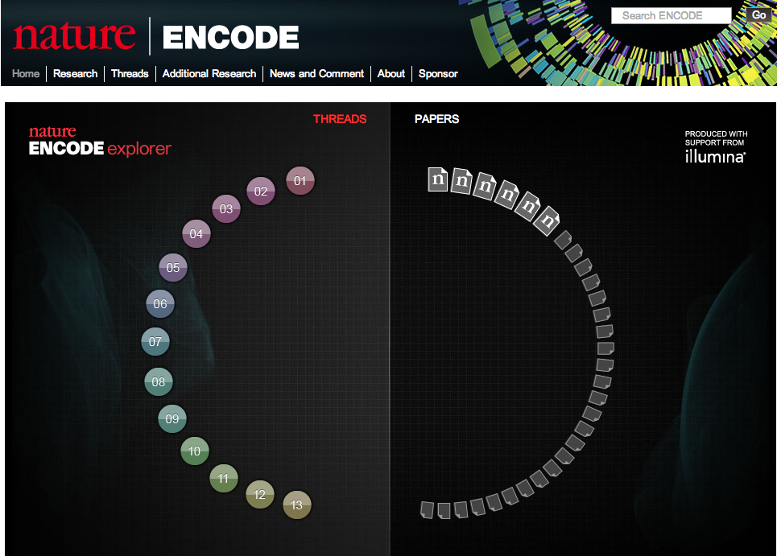
ENCODE, the Encyclopedia of DNA Elements, is a project funded by the National Human Genome Research Institute to identify all regions of transcription, transcription factor association, chromatin structure and histone modification in the human genome sequence.
Notes:
2012

Slide 7
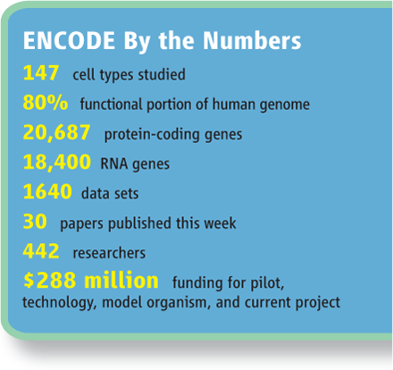
ENCyclopedia Of Dna Elements
Cumulatively, we observed a total of 62.1% and 74.7% of the human genome to be covered by either processed or primary transcripts, respectively, with no cell line showing more than 56.7% of the union of the expressed transcriptomes across all cell lines.

Slide 8
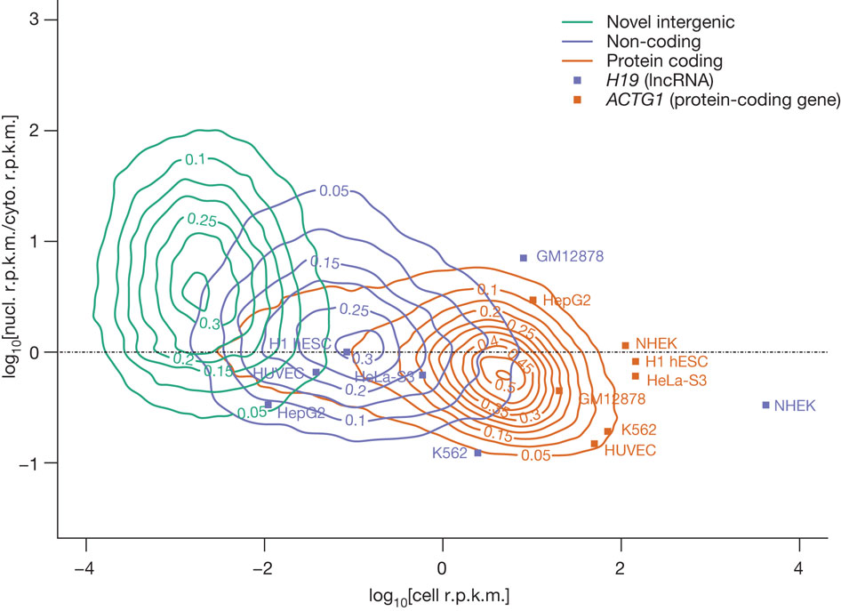
Different kind of RNAs have different expression values
Landscape of transcription in human cells, S Djebali et al. Nature 2012

Slide 9
What defines RNA depends on how you look at it
Adapted from Landscape of transcription in human cells, S Djebali et al. Nature 2012

Slide 10
One gene many different mRNAs

Slide 11
Defining functional DNA elements in the human genome
Statement
A priori, we should not expect the transcriptome to consist exclusively of functional RNAs.
Why is that
Zero tolerance for errant transcripts would come at high cost in the proofreading machinery needed to perfectly gate RNA polymerase and splicing activities, or to instantly eliminate spurious transcripts.
In general, sequences encoding RNAs transcribed by noisy transcriptional machinery are expected to be less constrained, which is consistent with data shown here for very low abundance RNA
Consequence
Thus, one should have high confidence that the subset of the genome with large signals for RNA or chromatin signatures coupled with strong conservation is functional and will be supported by appropriate genetic tests.
In contrast, the larger proportion of genome with reproducible but low biochemical signal strength and less evolutionary conservation is challenging to parse between specific functions and biological noise.

Slide 12
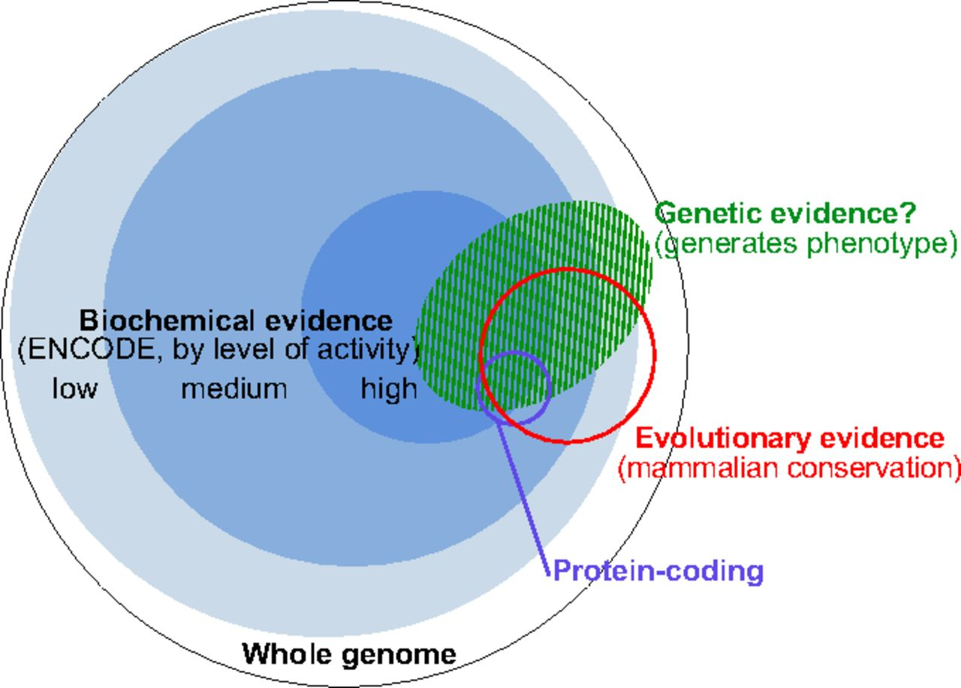
Biochemical evidence not enough to identify functional RNAs
Defining functional DNA elements in the human genome
Kellis M et al. PNAS 2014;111:6131-6138
Notes:
The complementary nature of evolutionary, biochemical, and genetic evidence. The outer circle represents the human genome. Blue discs represent DNA sequences acted upon biochemically and partitioned by their levels of signal [combined 10th percentiles of different ENCODE data types for high, combined 50th percentiles for medium, and all significant signals for low (see Reconciling Genetic, Evolutionary, and Biochemical Estimates and Fig. 2)]. The red circle represents, at the same scale, DNA with signatures of evolutionary constraint (GERP++ elements derived from 34mammal alignments). Overlaps among the sequences having biochemical and evolutionarily evidence were computed in this work (Fig. 3 and SI Methods). The small purple circle represents protein-coding nucleotides (Gencode). The green shaded domain conceptually represents DNA that produces a phenotype upon alteration, although we lack well-developed summary estimates for the amount of genetic evidence and its relationship with the other types. This summary of our understanding in early 2014 will likely evolve substantially with more data and more refined experimental and analytical methods.

Slide 13
RNA seq course

Slide 14
The RNA seq course
From RNA seq to reads (Introduction)
Mapping reads programs (Monday)
Transcriptome reconstruction using reference (Monday)
Transcriptome reconstruction without reference (Monday)
QC analysis (Tuesday)
Differential expression analysis (Tuesday)
miRNA analysis (Tuesday)
Gene set analysis (Wednesday)
Long RNA seq analysis(Thursday)
Single cell analysis (Wednesday)

Slide 15
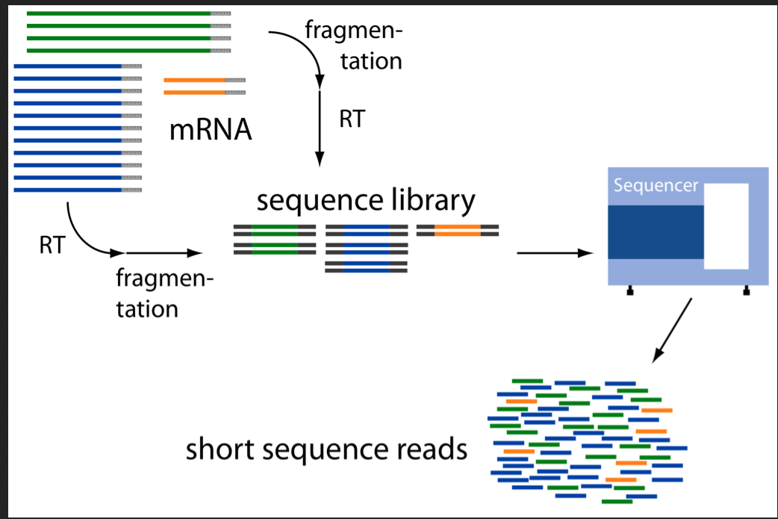
How are RNA-seq data generated?
Sampling process

Slide 16
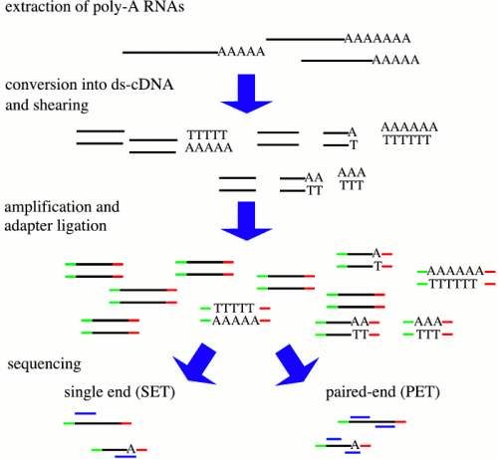
Depending on the different steps you will get different results
RNA->
AAAAAAAA
PolyA (mRNA)
RiboMinus (- rRNA)
Size <50 nt (miRNA )
…..
enrichments ->
Size of fragment
Strand specific
5’ end specific
3’ end specific
…..
library ->
reads ->
Single end (1 read per fragment)
Paired end (2 reads per fragment)

Slide 17
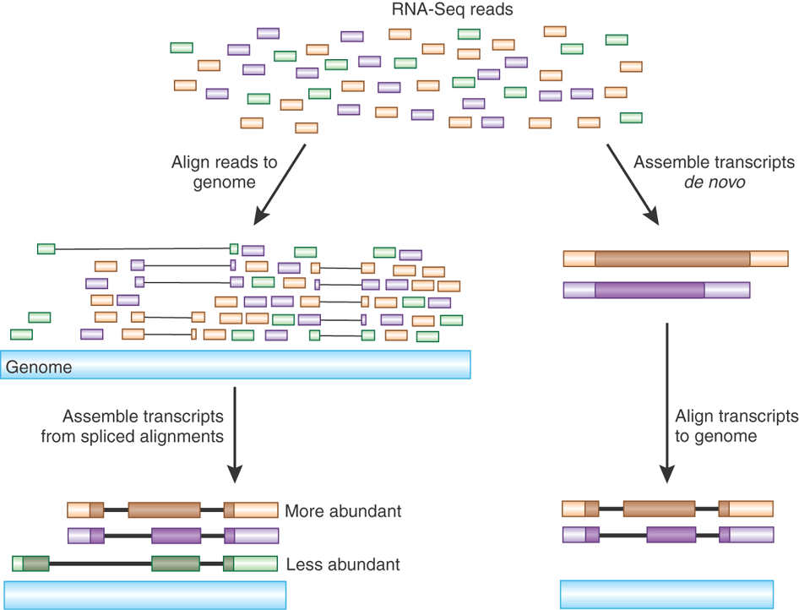

Slide 18
Promises and pitfalls
Long reads
Low throughput (-)
Complete transcripts (+)
Only highly expressed genes (--)
Expensive (-)
Low background noise (+)
Easy downstream analysis (+)
short reads
High throughput (+)
Fractions of transcripts (-)
Full dynamic range (+-)
Unlimited dynamic range (+)
Cheap (+)
Low background noise (+)
Strand specificity (+)
Re-sequencing (+)

Slide 19
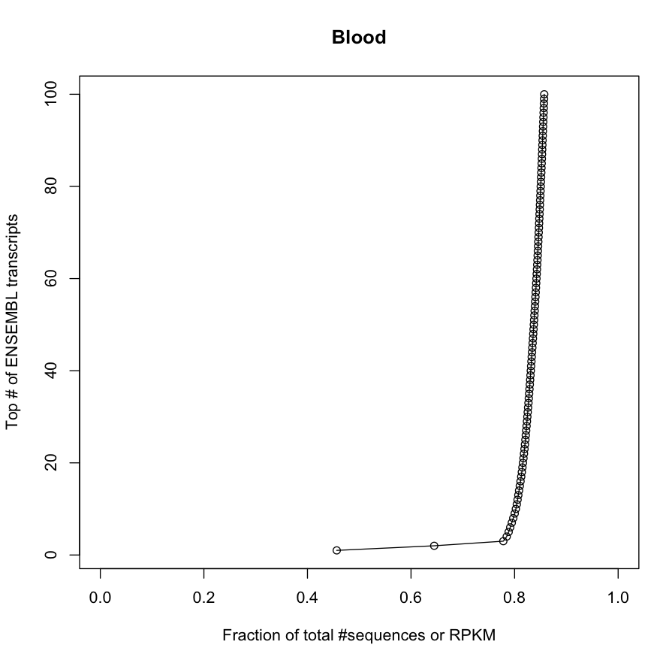
RNA seq reads correspond directly to abundance of RNAs in the sample
Notes:
hemglobulin

Slide 20
Map reads to reference

Slide 21
Transcriptome assembly using reference

Slide 22
Transcriptome assembly without reference

Slide 24
Quality control -samples might not be what you think they are
Experiments go wrong
30 samples with 5 steps from samples to reads has 150 potential steps for errors
Error rate 1/100 with 5 steps suggest that one of every 20 samples the reads does not represent the sample
Mixing samples
30 samples with 5 steps from samples to reads has ~24M potential mix ups of samples
Error rate 1/ 100 with 5 steps suggest that one of every 20 sample is mislabeled
Combine the two steps and approximately one of every 10 samples are wrong

Slide 25
RNA QC
Read quality
Mapping
statistics
Transcript quality
Compare between samples

Slide 26
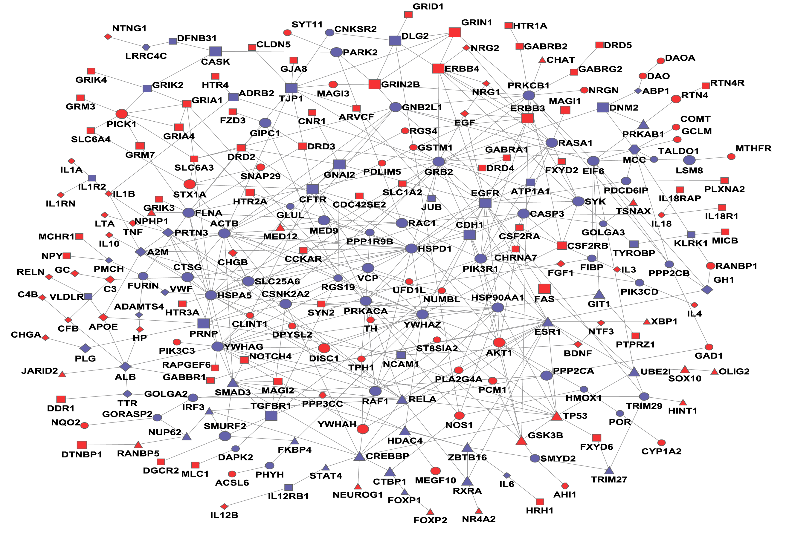
Differential expression analysis using univariate analysis
Typically univariate analysis (one gene at a time) – even though we know that genes are not independent

Slide 27
Gene set analysis and data integration

Slide 28
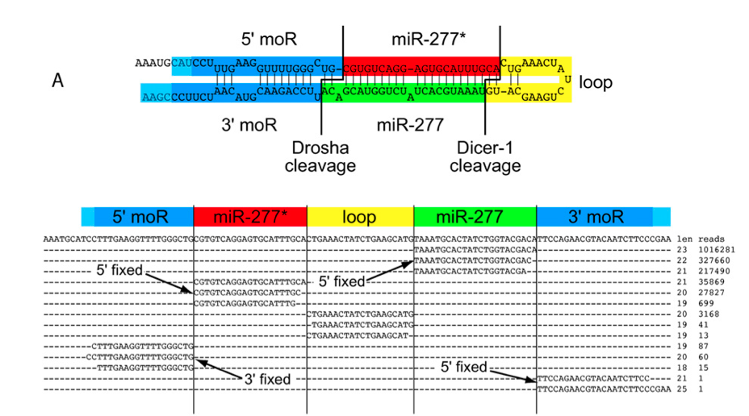
microRNA analysis (Johan)
(Berezikov et al. Genome Research, 2011.)
Notes:
Fixed 5’ ends of miRs
Variable 3’ ends – trimming, tailing

Slide 29
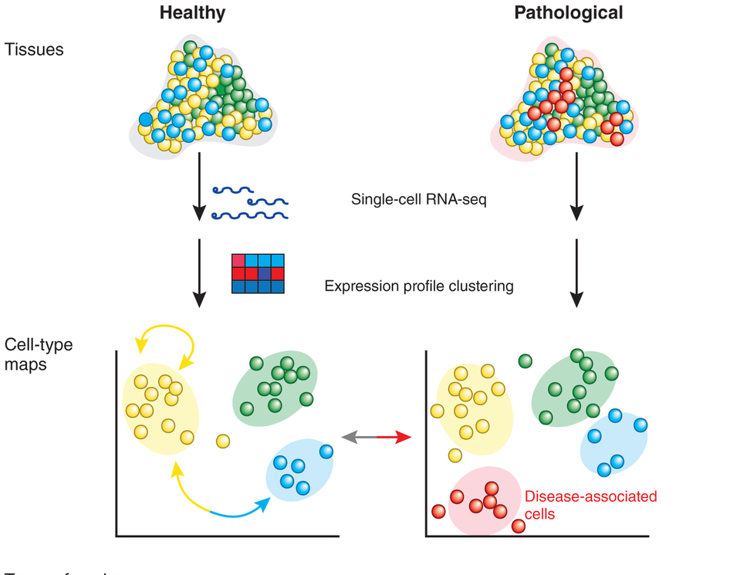
Single cell RNA-seq analysis
(Sandberg, Nature Methods 2014)

